Slide 1
Living Data Workshop 2
Link to this slideshow: http://bit.ly/LDWS2-19
Notes:
1 minute
Encourage students to download PDF version/google drive version.
PDF of slideshow is at https://www.dropbox.com/s/1jag5fq8nnuafne/Living%20Data%20Workshop%202%20-%202019.pdf?dl=0 but may not be the most up to date version. Check here for the latest.

Slide 2
In Workshop 1
Introduction to coding in Processing
Drawing with code
Loops and variables
Notes:
2 minutes (0:3)

Slide 3
In the pre-work
You have:
Loaded some data into Processing
Used loops to read each row of data, one-by-one
Notes:
2 minutes (0:3)

Slide 4
In this workshop...
Floats
Mapping variables
Drawing with data
Capturing your own data on your mobile
Notes:
2 minutes (0:3)

Slide 5
Download your data to use for this workshop
You will be using your own data for future workshops, but in the meantime we need to learn how to code
Everyone needs to download the ANDROID AND IPHONE datasets so we can go through their differences
http://bit.ly/LDWS2-DATA-19
Download “android-data.csv”, “ios-daily.csv” and “ios-hourly.csv”

Slide 6
Exploring our data
CSV stands for Comma Separated Values
One row per line. Each column is separated by a comma
2019,2,26,3720,2.45,113,0:35
2019,2,27,0,0.00,0,0:00
2019,2,28,737,0.52,22,0:06
2019,3,1,6586,4.61,200,1:03
2019,3,2,15545,10.88,474,2:13

Slide 7
Exploring our data
CSV stands for Comma Separated Values
One row per line. Each column is separated by a comma
2019, 2, 26, 3720, 2.45, 113, 0:35
2019, 2, 27, 0, 0.00, 0, 0:00
2019, 2, 28, 737, 0.52, 22, 0:06
2019, 3, 1, 6586, 4.61, 200, 1:03
2019, 3, 2, 15545, 10.88, 474, 2:13
Notes:
This data came from Accupedo on Android

Slide 8
Exploring our data
The first row might be a header. Headers describe the data.
year, month, day, steps, dist, kcal, duration
2019, 2, 26, 3720, 2.45, 113, 0:35
2019, 2, 27, 0, 0.00, 0, 0:00
2019, 2, 28, 737, 0.52, 22, 0:06
2019, 3, 1, 6586, 4.61, 200, 1:03
2019, 3, 2, 15545, 10.88, 474, 2:13
Notes:
Headers have to be manually added.

Slide 9
Look at your data
Look at your data “android-data.csv”, “ios-daily.csv” and “ios-hourly.csv”
Open your datasets in EXCEL so we can see what TYPE of data there is
Q: Which of the three datasets have a header, and which ones don’t?
Q: for the datasets WITH a header, what ARE the headers?

Slide 10
Look at your data
Q: Which of the three datasets have a header, and which ones don’t?
ios-daily and ios-hourly.csv have headers, android-data.csv does NOT have headers
Q: for the datasets WITH a header, what ARE the headers?
ios-daily.csv has the headers “Start”, “Finish” “Active Calories (kcal)”, “Heart rate”, “Steps(count)”
ios-hourly.csv has the headers “Start”, “Finish”, “Heart rate” and “Steps(count)”

Slide 11
Loading Data (recap)
Create a variable called myData with a type of Table
Table myData;
myData = loadTable("hours_data.csv", "header");
Opens a data file on your computer
The name of the file to open.
Tells Processing to treat the first-row as a header instead of as data.
Store the loaded data in myData
Processing Reference: https://processing.org/reference/loadTable_.html

Slide 12
loadTable() Syntax question
The syntax for the loadTable function is: loadTable(filename, options)
Go to the processing reference website for loadTable and answer the following question:
What can I replace options with when I call the loadTable(filename, options) function?
Can I leave options empty?
When I type in the filename, do I need to put in the file type as well?
Load up your android-data.csv file and test to see if it works (press play)

Slide 13
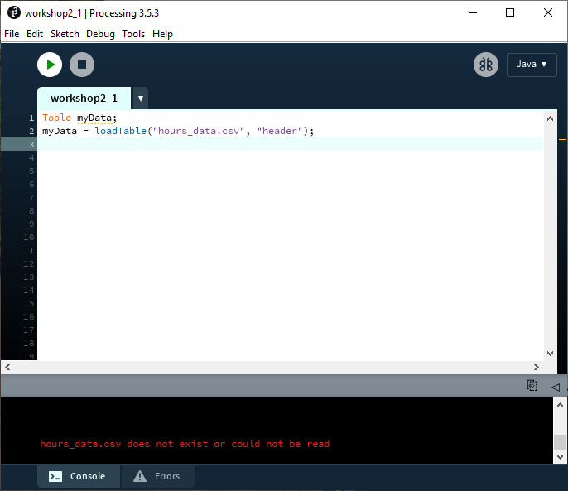
What could go wrong?
You may get this message in the console:
hours_data.csv does not exist or could not be read
Check two things:
Filename is exactly correct
Does it end with .csv?
No typos
Capitalisation and spaces matter
File has been dragged into Processing (see Workshop 2 Sheet)

Slide 14
Reading Data (recap)
Create a variable called numRows with type Int
On the Table called myData, find the number of rows.
int numRows = myData.getRowCount();
println("There are", numRows, "rows of data");
Print some info to the console.
Create a message that includes the number of rows.
Processing Reference: https://processing.org/reference/Table_getRowCount_.html

Slide 15
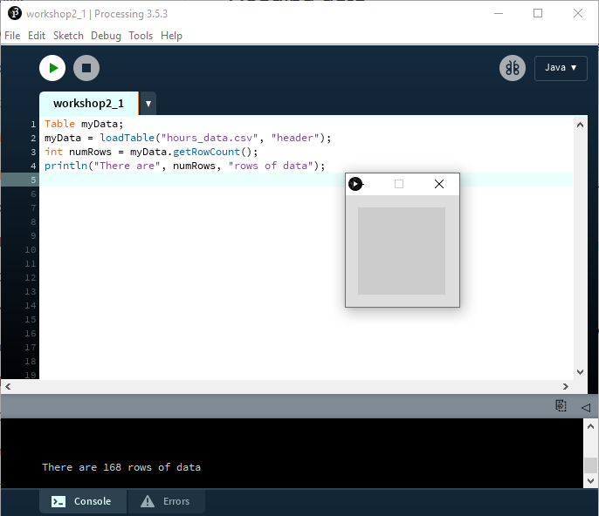
Checking that it works
Nothing shows up in the sketch window…
Because we haven’t told it to draw anything.
But we can see our message in the console.

Slide 16
Table object syntax questions
The Table object (which you are using to hold the data of the .csv file) has a series of ‘methods’ you can perform with it, one of which is the .getRowCount() method.
Using the Processing reference for the Table object, answer the following questions
What type of data does the .getRowCount() method return? A string, int or float?
What method is available for me to remove the 5th row of this table? How would I write it? How would I verify the 5th row has been removed?
What method is available for me to retrieve the float in the 2nd row and 3rd column of the table?

Slide 17
Reading Data (recap)
Set up a loop to run numRows number of times.
for (int i = 0; i < numRows; i++) {
float value = myData.getFloat(i, "Steps (average per min)");
println(value);
}
Get a value from a column in myData
What the column is called (i.e. it’s header label)
Which row number to get the data from
Print this value to the console
Processing Reference: https://processing.org/reference/Table_getFloat_.html

Slide 18
Floats
In this example, we added a new concept - a datatype called float
Short for floating point - lets you have decimal points:
i.e.
int pi = 3;
float pi = 3.14159;
Processing Reference: https://processing.org/reference/float.html
Notes:
Add a note that trying to store a float into an int won’t work. You’d lose anything after the decimal place, but processing will also throw an error.

Slide 19
Floats
Remember that you can’t assign a float to an int
Doing this:
int pi = 3.14159;
Results in an error:
cannot convert from float to int
Processing Reference: https://processing.org/reference/float.html

Slide 20
Mapping
In maths, a mapping refers to applying a function to convert one range of data, to another.
0
13
27
45
168
489
1204
0.0
1.0797342
2.2425249
3.7375417
13.953489
40.614616
100.0
Notes:
What is the minimum and maximum values in your dataset?

Slide 21
Why do mapping?
Your data is lots of:
Very small numbers: 0.3555, 0.200550, 0.455555
Very big numbers 12323, 343453, 123123, 3212312
But your output needs:
To fit within the width of the screen
Stay within the bounds of what a colour code can be (i.e. max 255)

Slide 22
map() function
Syntax
map(value, start1, stop1, start2, stop2);
Example:
float value = 489; float mapValue = map(value, 0, 1204, 0, 100); println(mapValue);
What is output to the console?
Parameters
value value to be converted
start1 lower bound of current range
stop1 upper bound of current range
start2 lower bound of the target range
stop2 upper bound of the target range
Processing Reference: https://processing.org/reference/map_.html

Slide 23
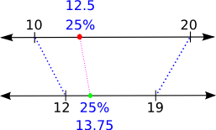
The map(a, b, c, d, e) function
Image to right:
Input range: 10, 20
Output range: 12, 19
Input value: 12.5
Output value: 13.75

Slide 24
Mapping our data
Before we can use map() properly, we need to know two more things about our data:
What’s the maximum value?
What’s the minimum value?
We could do this by hand… but. Let’s use code.
Notes:
The max and min functions are simple in operation, but conceptually pretty hard to get. Make sure to spend time on this.

Slide 25
Exercise

Slide 26
Finding the range of values
… // Leave the existing code here
float minValue = 0;
float maxValue = 0;
for(int i = 0; i < numRows; i++) {
float value = myData.getFloat(i, "Steps (average per min)");
minValue = min(value, minValue);
maxValue = max(value, maxValue);
println(value);
}
println("Minimum value: ", minValue);
println("Maximum value: ", maxValue);
Notes:
The max and min functions are simple in operation, but conceptually pretty hard to get. Make sure to spend time on this.

Slide 27
Drawing with data
… // Leave the existing code here
// Create a second loop to make a drawing
for(int i = 0; i < numRows; i++) {
float value = myData.getFloat(i, "Steps (average per min)");
float barHeight = map(value, minValue, maxValue, 0, height);
rect(i*5, 0, 5, barHeight);
}
Notes:
At this point, you will have to change the size of your sketch. size(1000, 300) works well.

Slide 28
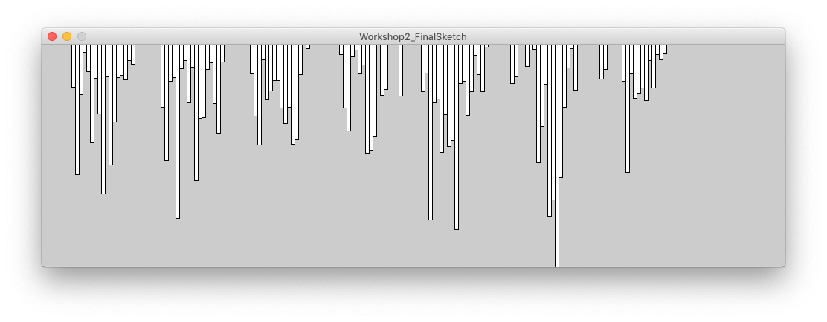
The Result

Slide 29
Capturing your own data

Slide 30




Capturing your own data
We are going to use your own activity as a source of data. We will keep track of your hourly or daily step count.
We need you to install an app to help capture this data.

Slide 31


Android
Apple

Slide 32
Important note
You do not need to create an account for either app
On iOS:
HealthKit is enabled by default. QSAccess will collect your logged data.
On Android:
Accupedo will start logging once you run it for the first time.

Slide 33
Sample Data
We have provided some data for you, captured on both Android and iOS.
Download these files from Dropbox.
http://bit.ly/LDWS2-DATA-19

Slide 34
Downloading your own data
We’ll walk you through the process of downloading your data in the pre-work for Workshop 3.

Slide 35
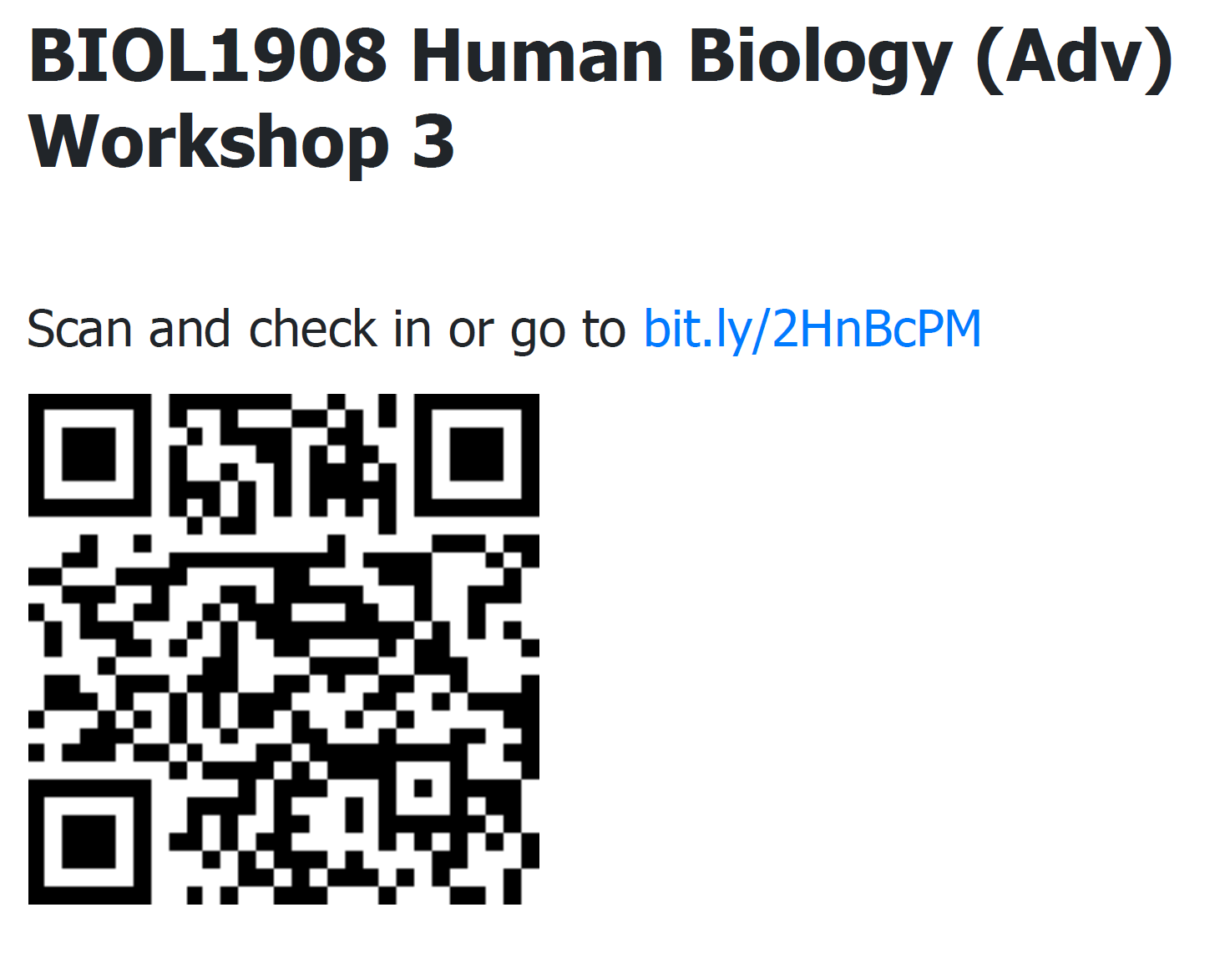

Slide 36
